Slide 1
MUSIC PLAYER
USING LINKED LIST
GROUP -8

Slide 2

Upgrade
GROUP - 8
Our Team
Our Project
Our Teams
Our Services
Code
22241A0506 - SUJAY.A
22241A0523 - SANJANA.D
22241A0546 - VAISHNAVI
22241A0554 - RAHIL
22241A0555 - ZAINAB
Achievements
Our Goals

Slide 3
Upgrade
GROUP - 8
Our Team
Our Project
Our Project
Music player Framework in C is a simple and efficient architecture that models the core functionality of modern day music player software such as Windows Media Player, VLC Media Player and Google Play Music.
We have recreated the experience of a simple music player that allows users to load a pool of songs from local storage and play tracks, create playlists and interact with it in a simple manner. The linked list data structure allows us to scrub through the entire playlist as per user’s instructions.
In this project , we use linked list to access the previous or next song in the given playlist.
Our Services
Code
Achievements
Our Goals

Slide 4
Upgrade
GROUP - 8
About Us
Our Services
Our Team
Our Services
Code
01
Display available songs
02
Create a Playlist
Achievements
03
Add a song to the playlist
04
Play music from playlist
Our Goals
05
Play the previous song
06
Play the next song
07
Information about the Artists
08
Delete a song from playlist

Slide 5
Upgrade
GROUP - 8
01
Display available songs
About Us
void list(){
int key;
printf("----------------------------------------------------------------------\n");
printf("1.Blinding Lights.\n2.Too_many_nights.\n3.Art_deco.\n4.Night_changes.\n5.Money_Trees.\n6.Perfect.\n7.Popular.\n8.Ice_cream.\n9.After_dark.\n10.Calm_down.\n11.Sdp-Interlude.\n12.Back To Main Menu.\n"); printf("----------------------------------------------------------------------\n");}
Our Team
Our Services
Code
Achievements
Our Goals
02
Create a Playlist
if (p <= 0 || p > c + 1 ){
printf("Enter a valid position\n"); main_menu();
}
else {
c++;
list1->data = n;
list1->next = NULL;
if (p == 1) {
list1->next = head;
head = list1;
}
int create_playlist() {
int p, i, n;
struct node *list1 = (struct node *)malloc(sizeof(struct node));
struct node *list2;
printf("Enter The Song Index Number and Its Position:");
scanf("%d", &n);
if(n==0){
system("cls");
main_menu();
return 0;
}if(n!=0){
scanf("%d",&p);

Slide 6
Upgrade
GROUP - 8
else {
list2 = head;
for (i = 0; i < p - 2; i++) {
list2 = list2->next;
}
list1->next = list2->next;
list2->next = list1;
}
}
}
return 0;
}
04
Play the previous song
About Us
Our Team
void prev(){
int n,k=0;
char* str;struct node *x=head;
if (l==0){
printf("No song was played previously.");
}else{
while (x != NULL) {
k++;
if(l-1 == k)
{
n=x->data;
str = assign(n);
song(str);
break;
}
x= x->next;
}
//printf("%d\n",p);
p--;
//printf("%d",l);
}
main_menu();
}
Our Services
Code
Achievements
03
Add a song to the playlist
Our Goals
void song(char str[50]){
const char* audioFile = str;
//printf("%o",audioFile);
printf("The song Currently playing is %s",str);
system(audioFile);}

Slide 7
Upgrade
GROUP - 8
05
Play the next song
06
Delete a song from playlist
About Us
Our Team
Our Services
void delete(){
int p, i;
struct node *temp1 = head, *temp2;
printf("Enter the Index of the song you want to delete:");
scanf("%d", &p);
if ((p <= 0) || p > c) {
printf("Enter a valid position\n");
}
else { c--;
if (p == 1)
{ head = temp1->next;
free(temp1); }
else {
for (i = 0; i < p - 2; i++) {
temp1 = temp1->next;
}temp2 = temp1->next;
temp1->next = temp2->next;
free(temp2); }
main_menu();
}
}
void next(){
int n,k=0,size=0;
char* str;struct node *x=head;
while ( x != NULL)
// check this again{ size++; x= x->next;
}//printf("\n%d %d",l,size);
if (l==size){
printf("This is the last song of the playlist.");
}else{
while (x != NULL) {
k++;
if(l+1 == k)
{
n=x->data;
str = assign(n);
song(str);
break; }
x= x->next;
//printf("%d\n%d",p,l);
p=p+1; } }
main_menu();}
Code
Achievements
Our Goals

Slide 8
Upgrade
GROUP - 8
void delete_playlist(){
int p=0, i;
struct node *temp1 = head, *temp2;
struct node *x=head;
while(x !=NULL){
p++;
c--;
if (p == 1) {
head = temp1->next; free(temp1);
}
else {
for (i = 0; i < p - 2; i++) {
temp1 = temp1->next;
}
temp2 = temp1->next;
temp1->next = temp2->next; free(temp2);
}
}
}
07
Main Code
About Us
Our Team
void main_menu(){
int c,d,key;
printf("\n----------------------------------------------------------------------\n");
printf(" MAIN MENU\n");
printf("----------------------------------------------------------------------\n");
printf(" 1 | Display all available songs\n");
printf(" 2 | Create a playlist\n");
printf(" 3 | Show playlist\n");
printf(" 4 | Play the music from the playlist\n");
printf(" 5 | Add a song to the playlist\n");
printf(" 6 | Play previous track\n");
printf(" 7 | Play next track\n");
printf(" 8 | Show more information about the song playing\n");
printf(" 9 | Delete a song from the playlist\n");
printf(" -1 | Exit music player\n");
printf("----------------------------------------------------------------------\n");
printf(" Enter your choice below\n");
scanf("%d",&c);
switch(c){
case 1: system("cls");
list();
scanf("%d",&key);
Our Services
Code
Achievements
Our Goals

Slide 9
Upgrade
GROUP -8
if(key==12){
system("cls");
main_menu();
}
break;
case 2: system("cls");
list();
printf("Press '0' to stop adding\n" );
while(1){
create_playlist();
}
break;
case 3: display_playlist();
printf("Press '0' to direct to main menu.");
scanf("%d",&key);
if(key==0){
system("cls");
main_menu();
}
break;
case 4: display_playlist();
play_search();
break;
case 5 : printf("The playlist currrently is:\n");
display_playlist();
printf("List of songs available is:\n");
list();
create_playlist();
break;
case 6: prev();
break;
case 7: next();
break;
case 8: printf("More info about the currently playing is..... %s\n",str);
info();
printf("\nPress '0' to direct to main menu. ");
scanf("%d",&key);
if(key == 0){
system("cls");
main_menu();
}
break;
case 9: system("cls");
display_playlist();
delete();
break;
case -1: printf("Thank you for using our music player,\nPlease use us again....");
exit(0);
default: printf("Please selection a valid option.");
main_menu();
}
}
About Us
Our Team
Our Services
Code
Achievements
Our Goals

Slide 10
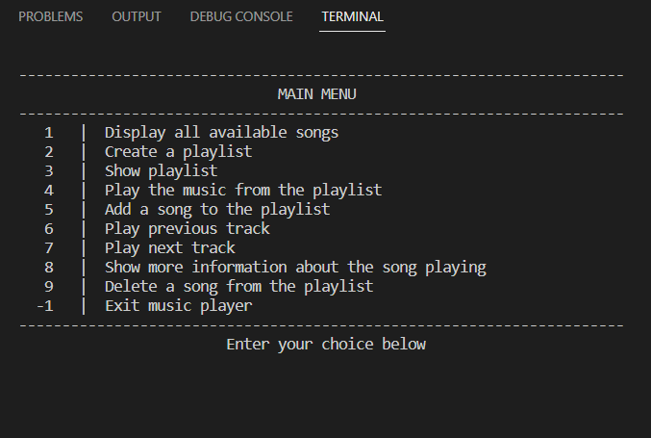
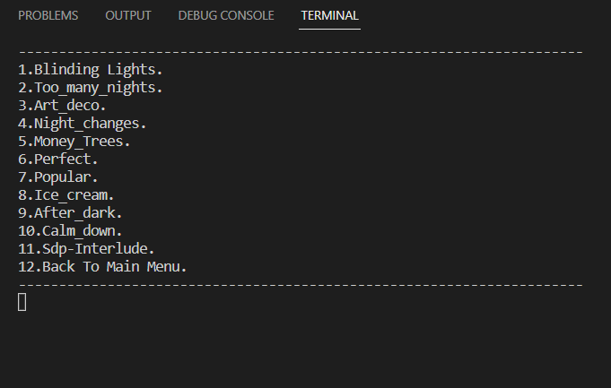
Upgrade
GROUP - 8
Output
Our Team
Our Project
Our Services
Code
Output
Our Goals

Slide 11
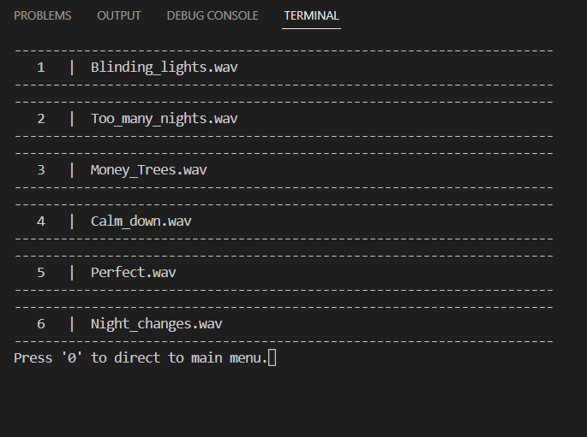
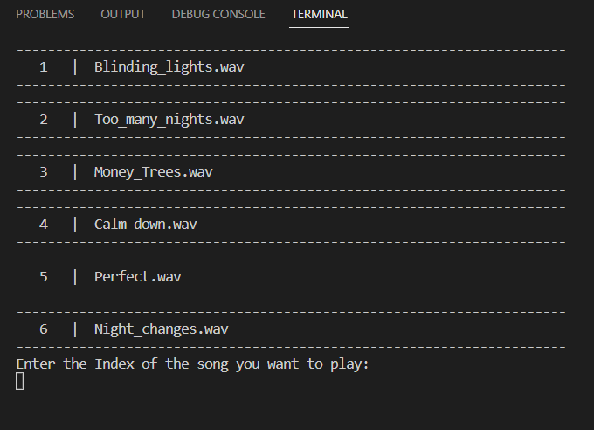
Upgrade
GROUP - 8
Output
Our Team
Our Project
Our Services
Code
Output
Our Goals

Slide 12
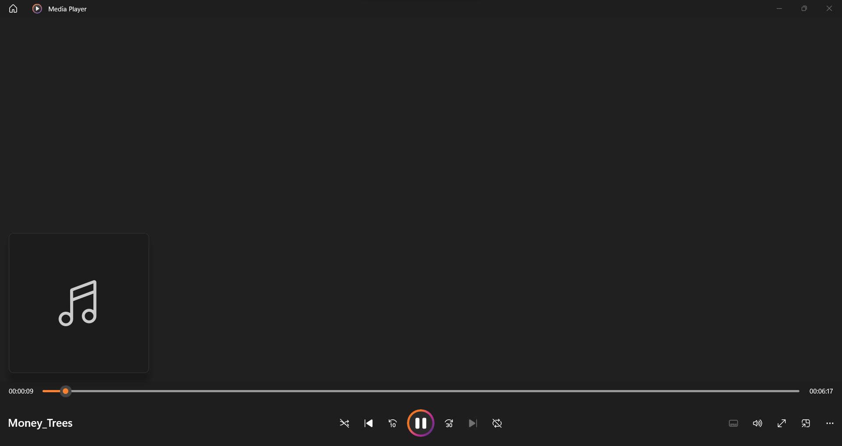
Upgrade
GROUP - 8
Output
Our Team
Our Project
Our Services
Code
Output
Our Goals

Slide 13
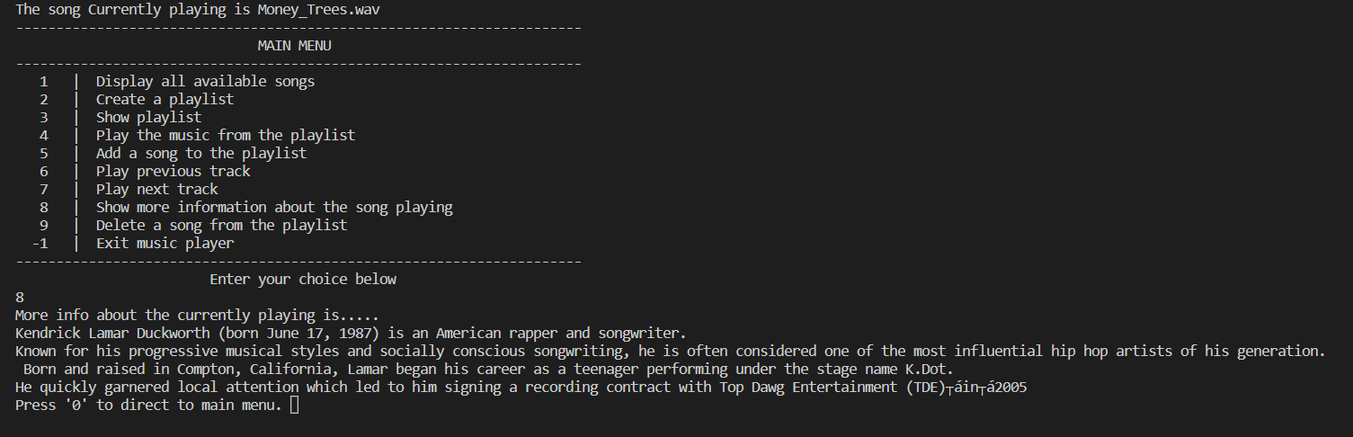
Upgrade
GROUP - 8
Output
Our Team
Our Project
Our Services
Code
Output
Our Goals

Slide 14
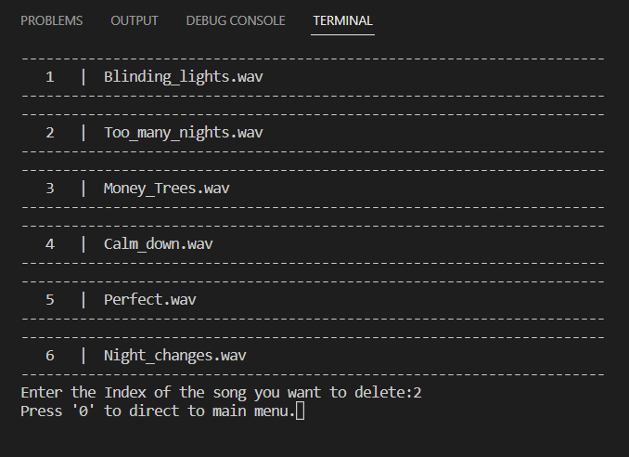
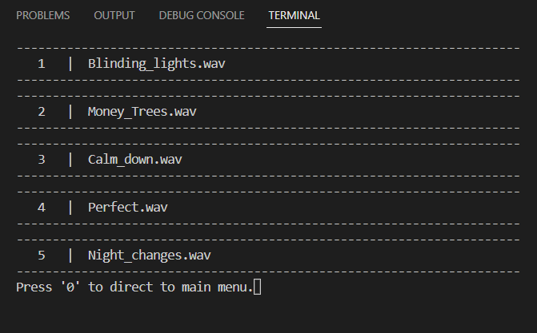
Upgrade
GROUP - 8
Output
Our Team
Our Project
Our Services
Code
Output
Our Goals

Slide 15

Thank You
Night Changes
One Direction
0:23
-3:25

